Slide 1
Road and Field Boundary Detection in Satellite Imagery
CSCE 5222 Feature Engineering
University of North Texas
Group 15
Prof. Xiaohui Yuan

Slide 2
Team Members
Harshavardhan Reddy Mallannagari Student ID – 11603389
Preethi Vahitha Sankineni Student ID -11607639
Sasidhar Yalamanchili Student ID – 11573866

Slide 3
Presentation Topics
Introduction
Problem Statement
Dataset Description
Ground Truth
Methodology
Pre – Analysis
Sobel Edge Detection
Canny Edge Detection
Harris Corner Detection
Hough Transform
DoG filter
Compare Ground Truth and Hough Transform Output
Compare Ground Truth and DoG filter Output
Quantitative Evaluation
Result
Conclusion

Slide 4
Introduction
Feature Engineering is the process of applying domain knowledge to design methods for extracting, refining, and representing features (properities, characteristics, and attributes) from data.
This project is about identifying the road and field boundaries in the given set of satellite images using feature engineering techniques.
Road and field boundary detection in satellite or aerial view images is very important in specific areas such as agriculture and urban plan designing.

Slide 5
Problem Statement
The main problem statement of this project is to detect the roads and field boundaries in the satellite images given by Professor.
To differentiate the roads and field boundaries from other line features such as waterbodies, railway lines, etc.
To perform tasks such as managing the field areas supplying resources, it is necessary that the maps of the roads and fields should be accurate and detailed.

Slide 6
Dataset
The project uses the dataset given by Professor Xiaohui Yuan.
The images utilized for this project are satellite-captured aerial images of various places in the United States, provided by the U.S. Department of Agriculture.
These images provide visual information about the landscape.
They are in jpeg format.
These images are cropped from the sections of the large images, and their pixel size is 1 m2.
A total of 9 satellite images of the land that consists of fields, mountains, baren land, and lakes etc.

Slide 7
Ground Truth Analysis
Ground Truth is the target or the real output that you want to obtain while training a model or algorithm.
So, here the Ground Truth of the images in the dataset acts as an asset in evaluating the models’ predictions.
We compare the results obtained from the models with the Ground Truth images.
Arivis Cloud website or apeer.com was used to do the manual annotation.
In the next slide, we tried to display all the Ground Truth images for the given dataset.

Slide 8
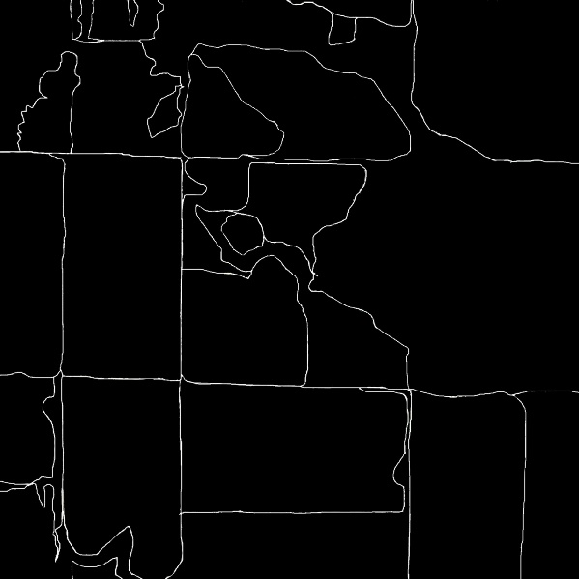
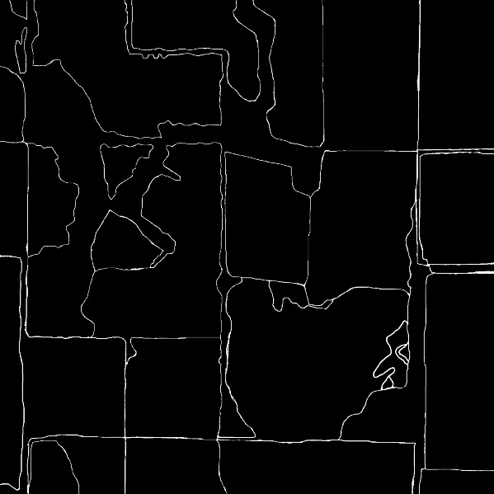
Field.jpg
L88a.jpg
L88b.jpg
L96a.jpg
L96b.jpg
L97a.jpg

Slide 9
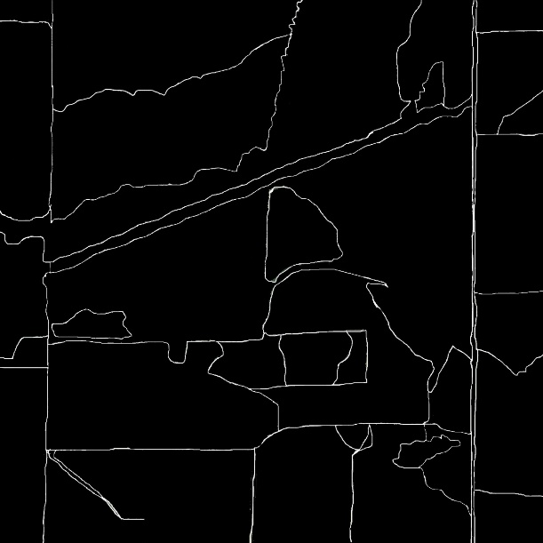
L97ba.jpg
W107a.jpg
W107b.jpg

Slide 10
Methodology
For the given project, we need to perform various image processing methods, edge detection techniques and accuracy evaluations.
Pre-processing : collect the data, apply some filters for image enhancement.
Apply Feature Engineering models –
Canny and Sobel edge detection methods to detect the edges in the images.
Harris Corner algorithm to find points in the image that help in identifying the boundaries.
Hough Transform is applied to detect the straight lines in the images that are equivalent to the boundaries of the fields and roads.
DoG filter is used for detecting edges and feature enhancement.
Quantitative Evaluation – accuracy, precision, SSIM (Structural Similarity Index Metric)

Slide 11
Pre – Analysis (Understanding image structure)
We read the image in the dataset and its ground truth.
Information about the image - bit depth, HSV components, channels.
Convert image to grayscale (gray image has single channel).
Dimensions of an image - i.e., (no.of rows) x (no.of columns) x (no.of channels)
Dimensions of image in dataset converted into grayscale - 2048 pixels (height) x 2048 pixels (width) x 1 channel.
Dimensions of all ground truth images is obtained in sizeOfImages.mlx file.

Slide 12
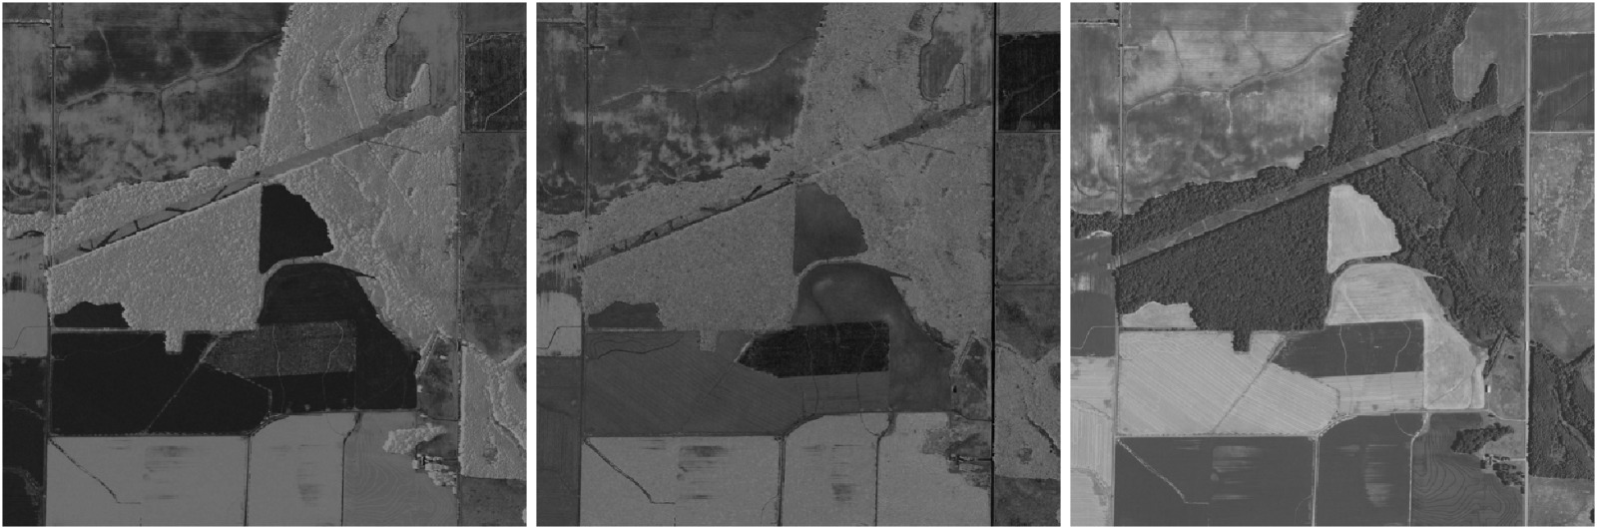
HSV Format of Image L97b

Slide 13
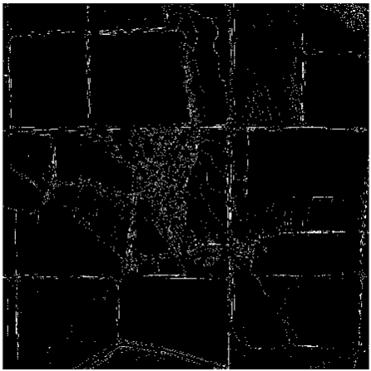
Sobel Edge Detection
Table 1. Sobel Edge Detector Accuracy
Model Name | Filter | Threshold | IOU
Sobel | None | Default | 7.875558
Sobel | Gaussian | 0.05 | 7.849831
Sobel | Median | 0.01 | 6.200332
Sobel | Histogram Equalization | Default | 6.428086
Sobel | Histogram Stretching | Default | 6.417841
It is a technique to detect edges in an image both vertically and horizontally.
We use ground truth as a benchmark to find out the accuracy of the model.
The intersection and union values of the ground truth image and the initial image are calculated to find the accuracy.
The accuracy and threshold values of the Sobel Edge Detector after applying each filter are observed.
The edges detected by Sobel are not that accurate when compared to the Ground Truth images.
Fig 1. Sobel Edge Detection for field.jpg

Slide 14
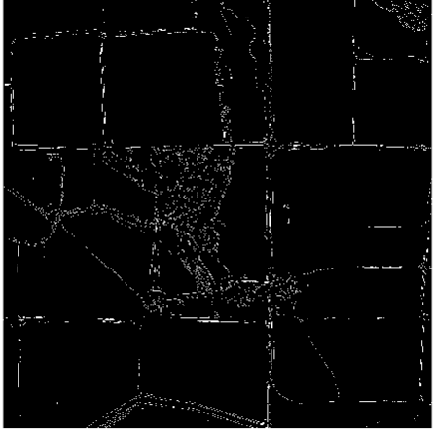
Canny Edge Detection
Table 2. Canny Edge Detector Accuracy
Model Name | Filter | Threshold | IOU
Canny | None | Default | 4.363802
Canny | Gaussian | 0.15 – 0.24 | 8.080580
Canny | Median | 0.15 – 0.24 | 7.679530
Canny | Histogram Equalization | Default | 3.991448
Canny | Histogram Stretching | Default | 6.928220
This filter aims at finding the strongest edges and the edges that are connected.
This technique blurs the image to suppress noise and detects the edges accurately with very few false edges.
The intersection and union values of the ground truth image and the initial image are calculated to find the accuracy.
The accuracy of Canny Edge Detection was evaluated using the fingIOUAccuracy() method i.e., Intersection over Union(IoU) metric is 4.618289.
The edges detected by Canny are not that accurate when compared to the Ground Truth images.
Fig 2. Canny Edge Detection for field.jpg

Slide 15
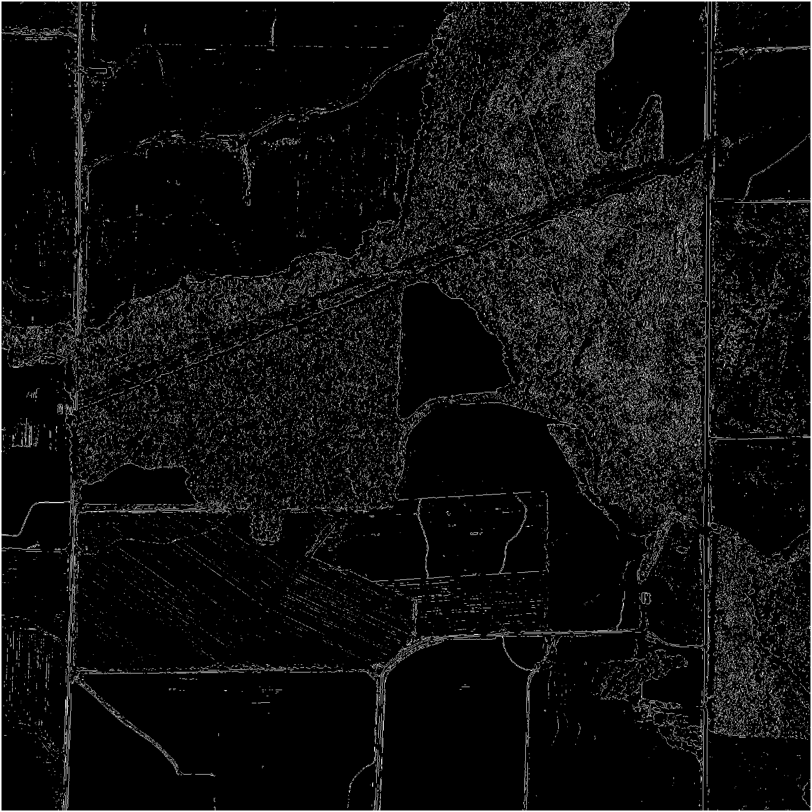
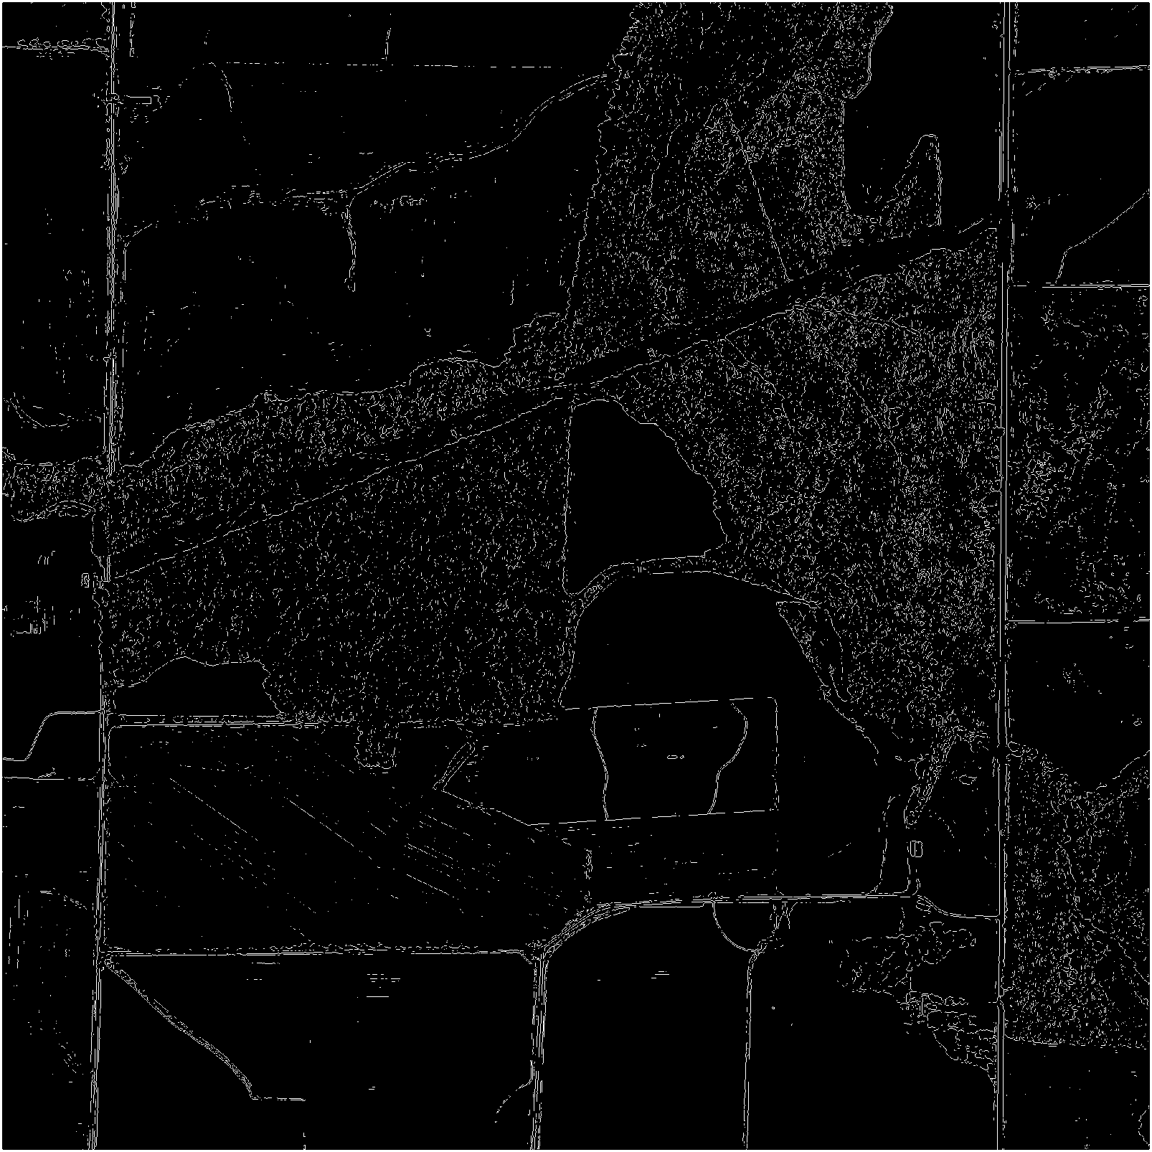
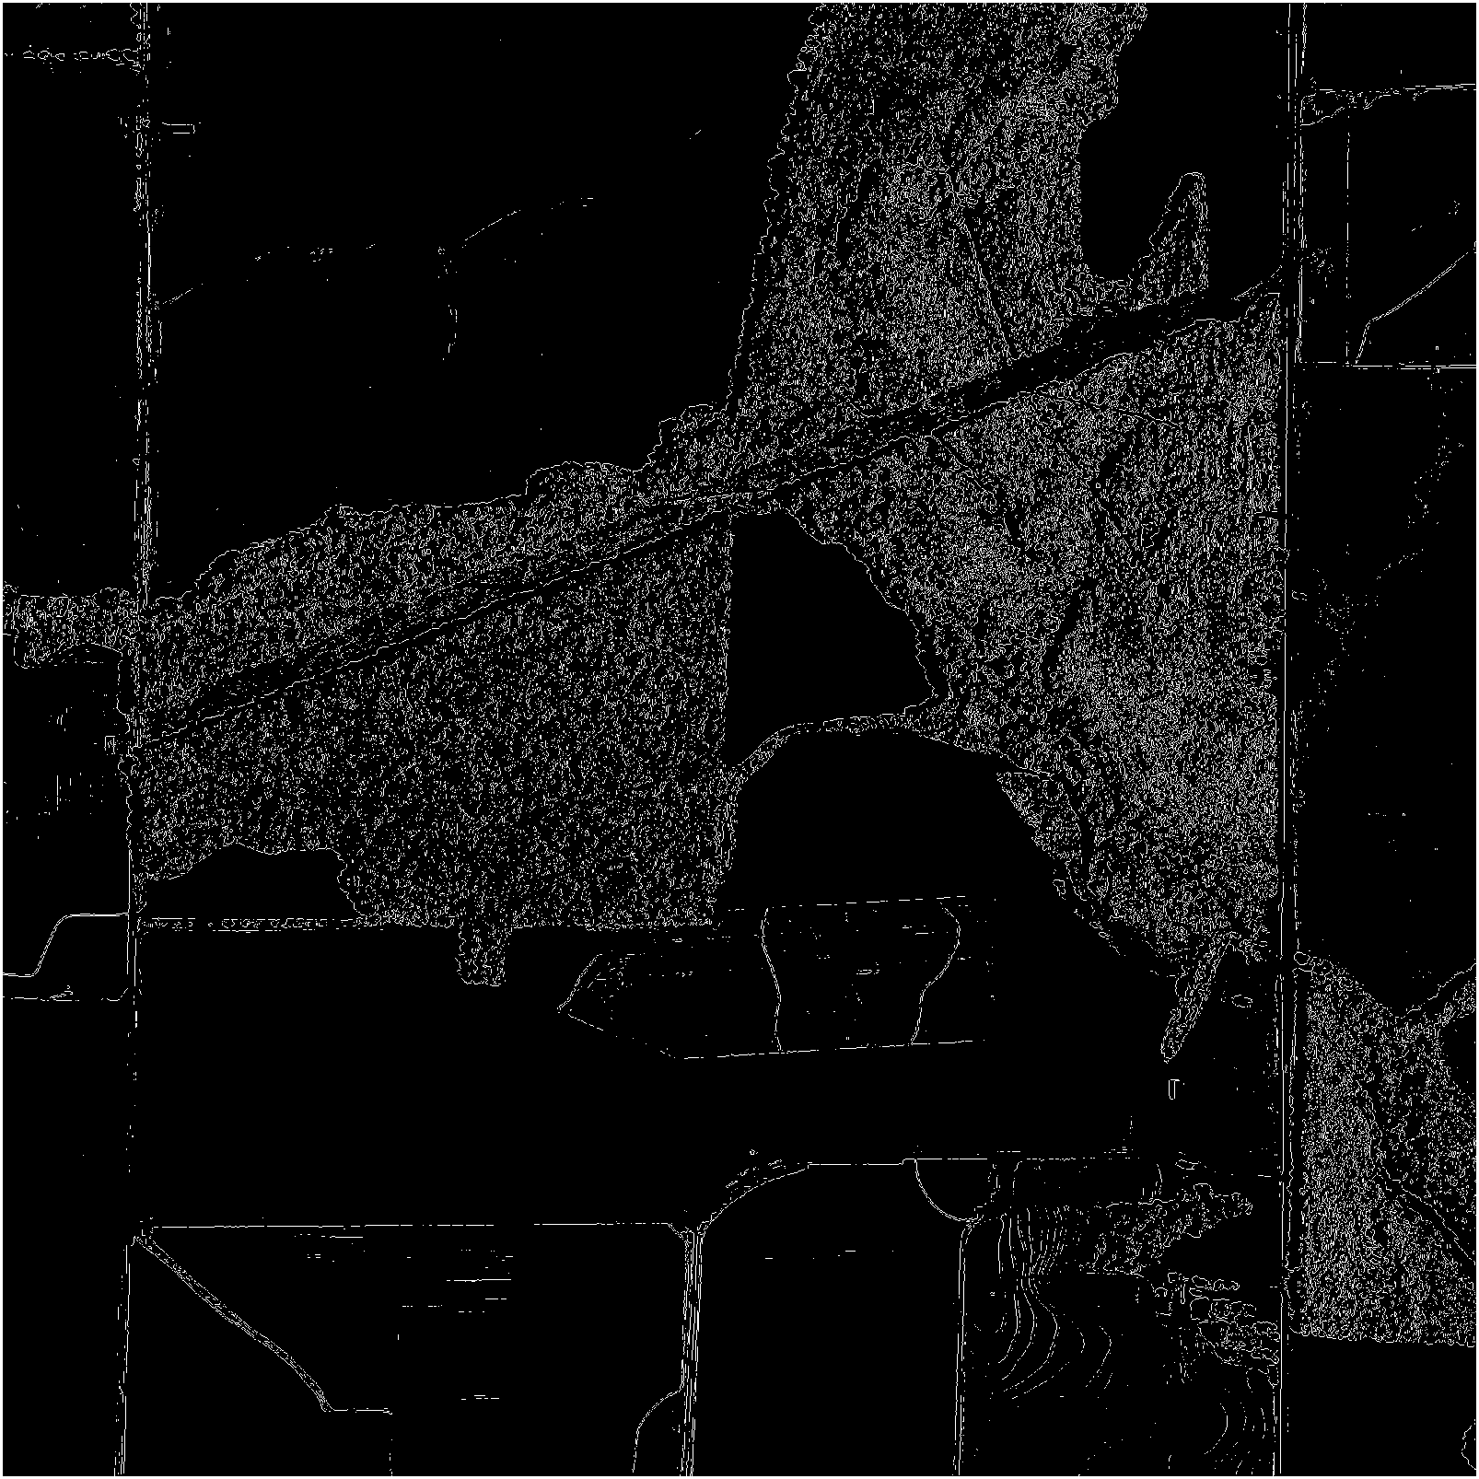
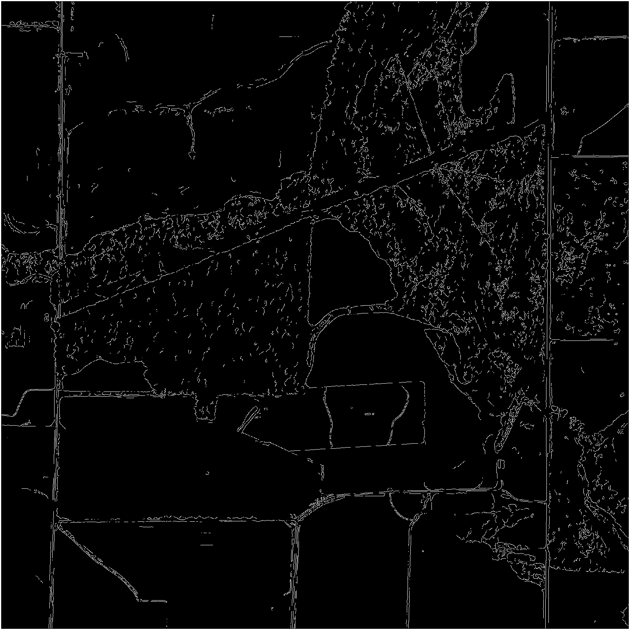
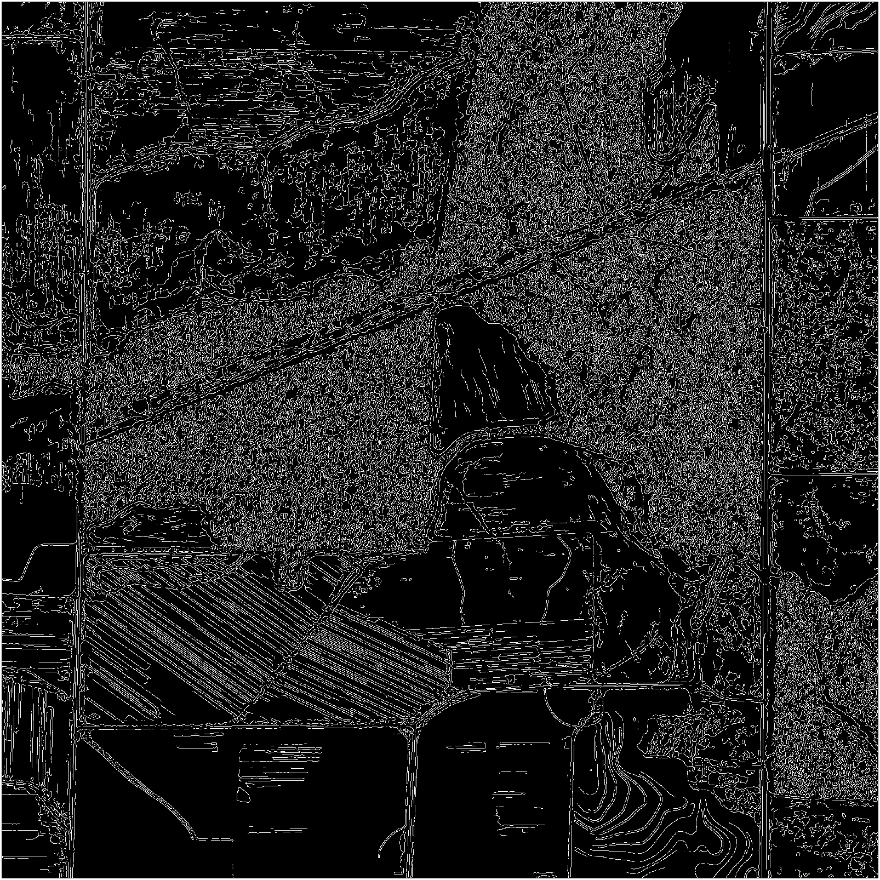
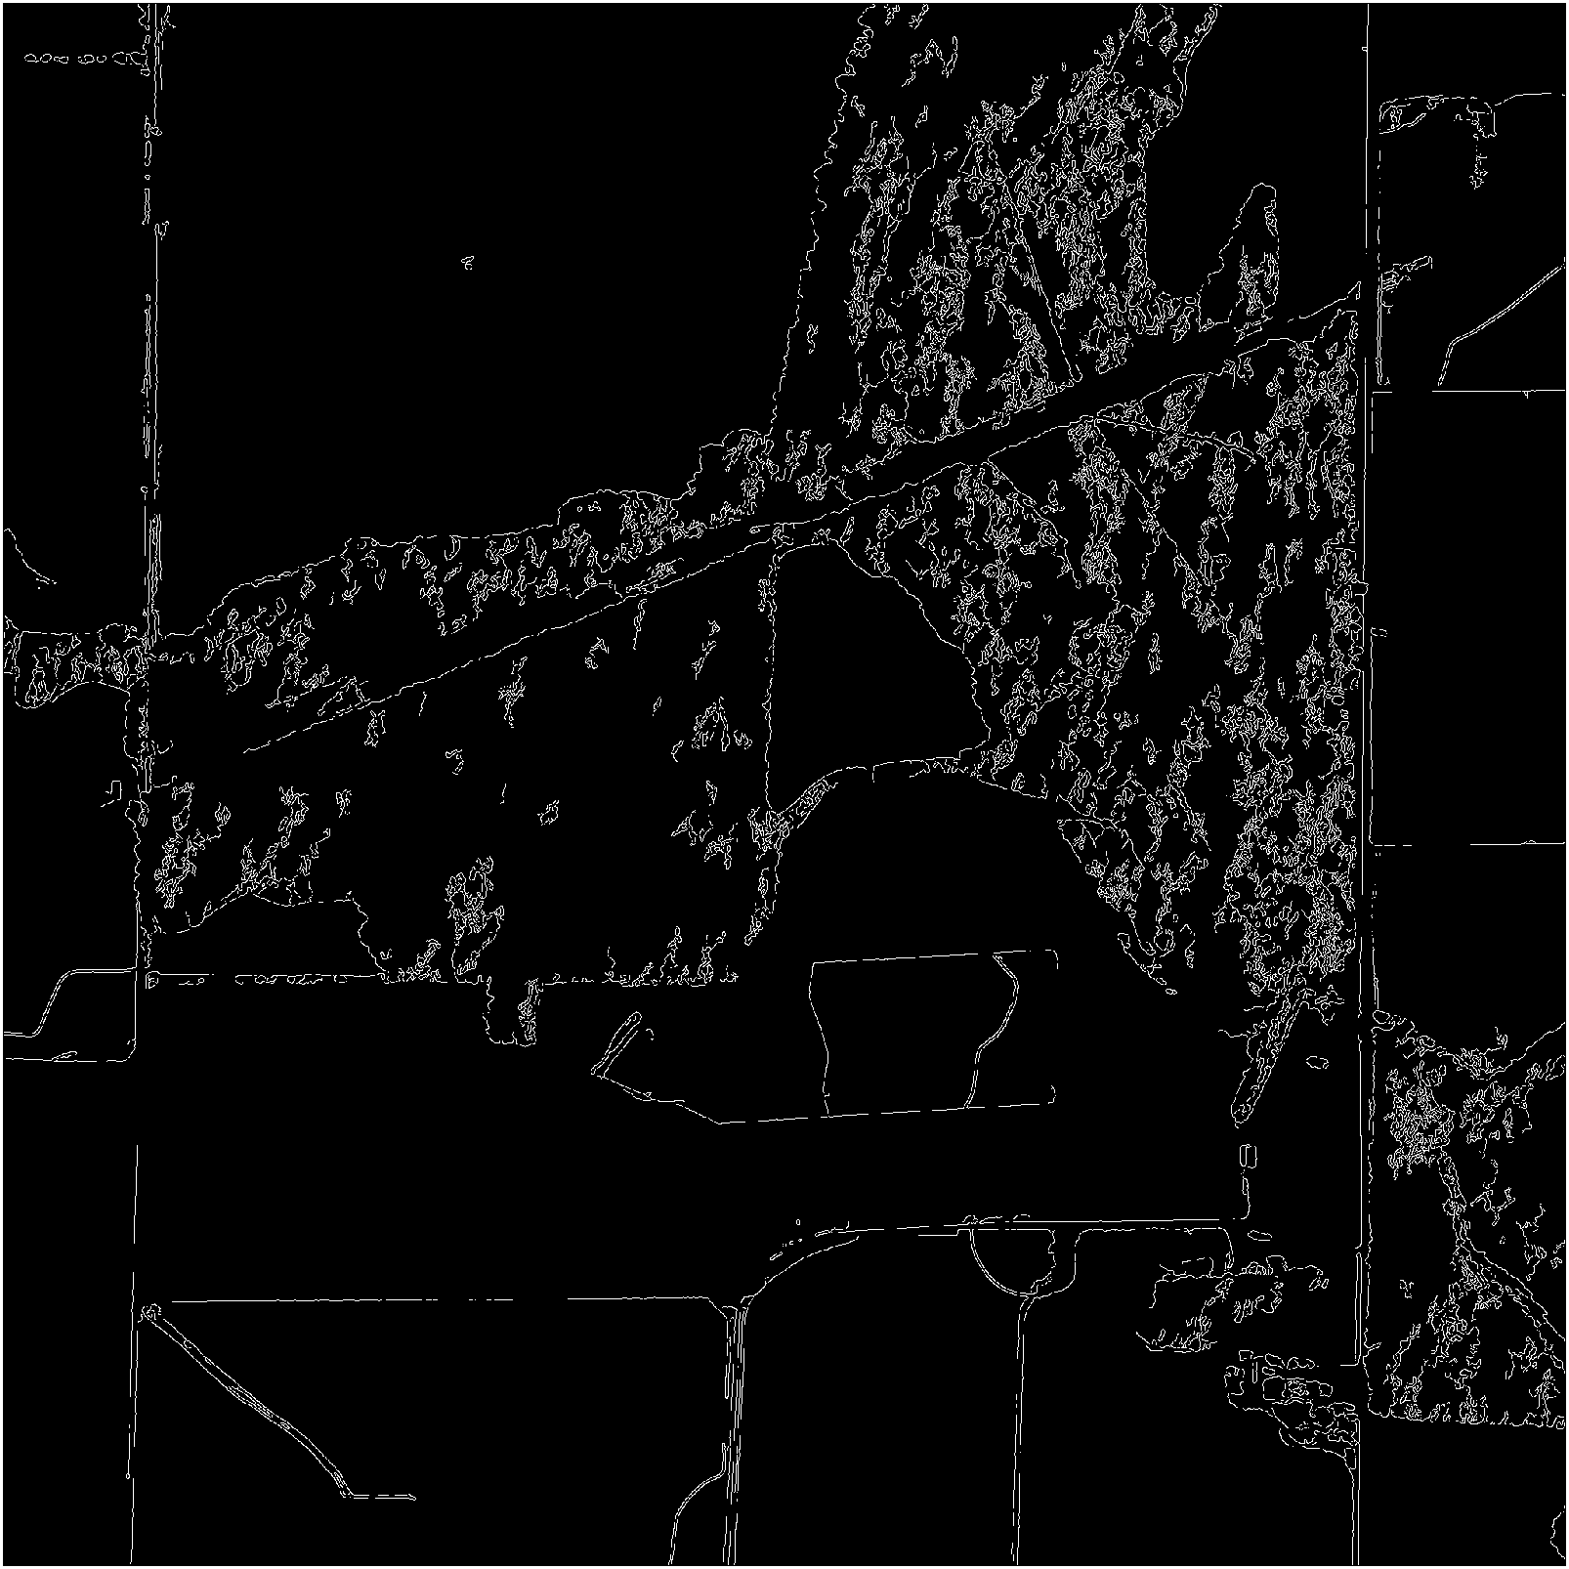
Sobel-T = 0.05
Sobel - Median filter[3x3]
Sobel – Histogram Eq
LT = 0.15 HT=0.24
Canny - Median filter[3x3]
Canny – Histogram stretching
Image L97b

Slide 16
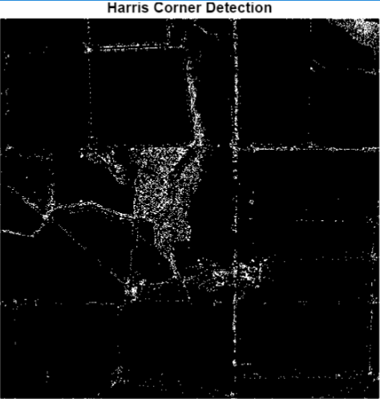
Harris Corner Detection
Harris Corner Detector is used to identify a corner by looking through a small window.
Window shifts in different directions to compute the intensity variations.
It is a multi-step process.
Compute the image gradients using Sobel operators.
Derive the elements of the Harris matrix.
Apply gaussian filter for smoothing.
Detect corner points using the threshold value.
The points detected by Canny are not that accurate when compared to the Ground Truth images.
Fig 3. Harris Corner Detection for field.jpg

Slide 17
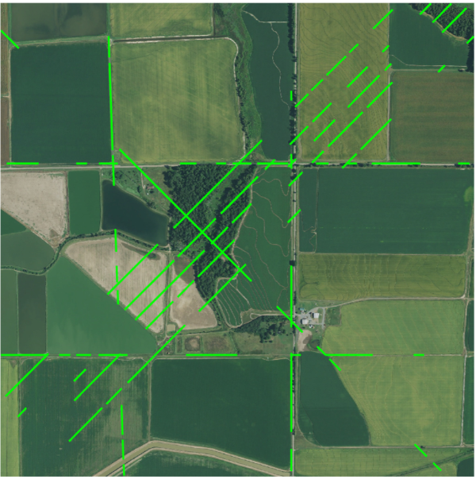
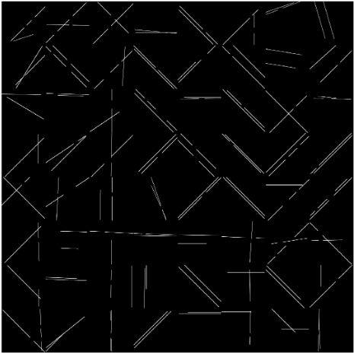
Hough Transform
A technique used to map an edge image that can identify the lines or curves (mathematical representations) present in the images.
Works well if the image is split into parts.
The images are split into 8x8 grid before performing Hough transform.
Hough transform performed twice –
considering only lines
Considering both lines and curves
The accuracy of Hough Transform model
Fig 4. Hough Transform fail case without splitting
Fig 5. Hough Transform (lines) for L88a.jpg

Slide 18
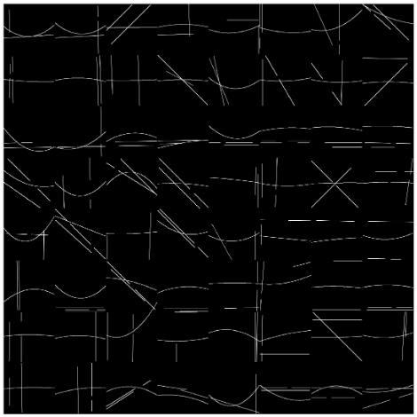
Hough Transform (curves)
This is the extension of the previous application.
Canny Edge detector is used to discover the edges in each sub image.
The accuracy obtained in detecting the edges using Hough Transform for L88a.jpg is 76.58
Fig 6. Hough Transform (curves) for L88a.jpg

Slide 19
Difference of Gaussians (DoG) Filter
The difference between two blurry versions of the same image obtained by applying two different standard deviations of gaussian filter is used to create the DoG filter.
The input image is converted into grayscale image.
Creating two gaussian filters with different standard deviation values.
Alpha bending technique is used to place the binarized image on top of the original gray image.

Slide 20
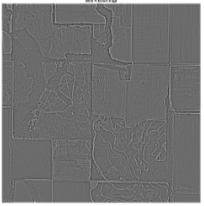
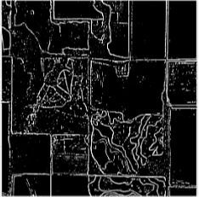
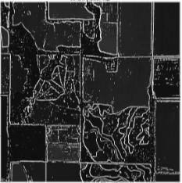
Fig 7. DoG filtered image of L88b.jpg
Fig 8. Binary image of L88b.jpg
Fig 9. Overlay on Grayscale of L88b.jpg

Slide 21
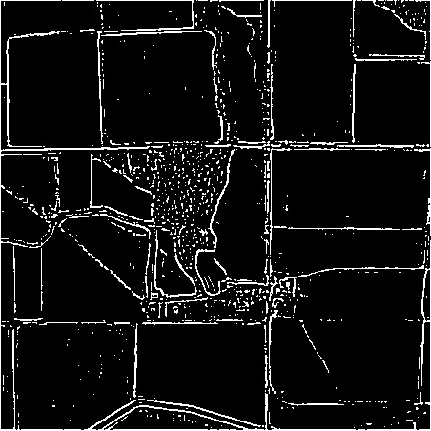
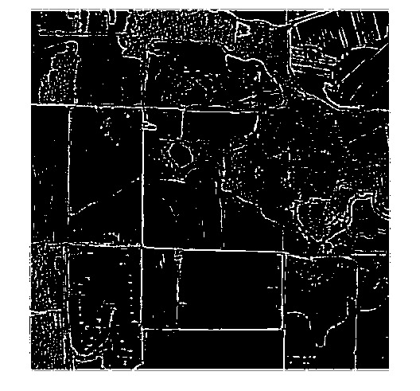
DoG on all images
Fig 10. DoG on Field.jpg
Fig 11. DoG on L88a.jpg
Fig 12. DoG on L88b.jpg

Slide 22
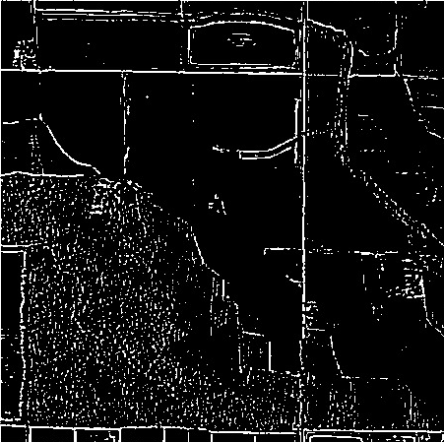
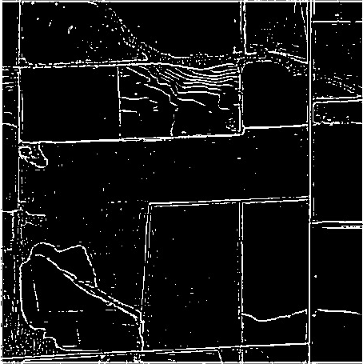
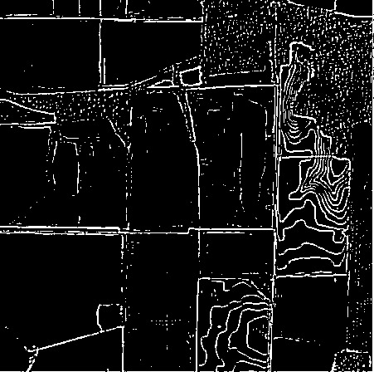
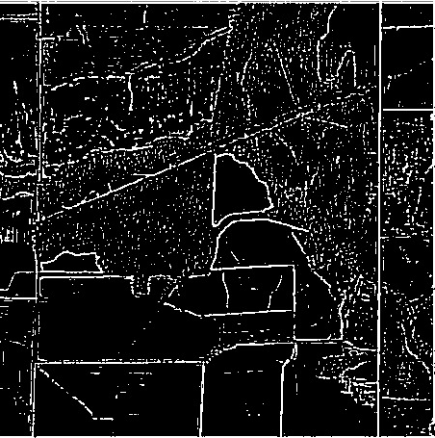
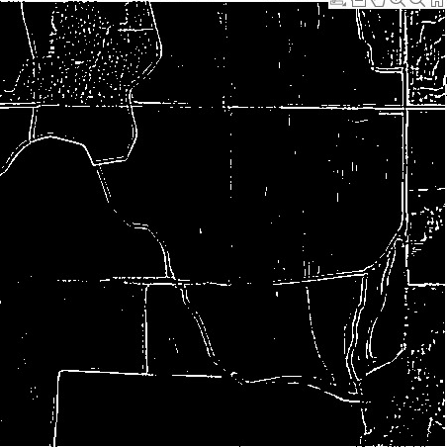
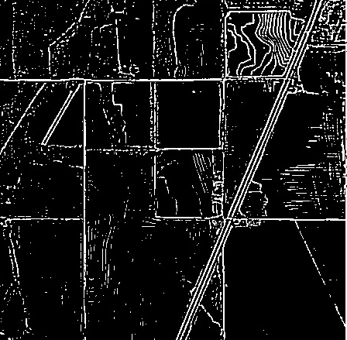
Fig 13. DoG on L96a.jpg
Fig 14. DoG on L96b.jpg
Fig 15. DoG on L97a.jpg
Fig 16. DoG on L97b.jpg
Fig 17. DoG on W107a.jpg
Fig 18. DoG on W107b.jpg

Slide 23
Compare Ground Truth and Hough Transform Output
Fig 19. Ground Truth L88a.jpg
Fig 20. Hough Transform (curves) for L88a.jpg

Slide 24
Compare Ground Truth and DoG Output
Fig 21. Ground Truth Field.jpg
Fig 20. DoG Field.jpg

Slide 25
Quantitative Evaluation
The evaluation of the models’ performance is done using evaluation metrics like precision, SSIM, and Intersection over Union (IOU) to find accuracy of the validation dataset.
The accuracy score is calculated by flattening the arrays and comparing the values in the arrays of both images.
Structural Similarity Index Metric (SSIM) measures degradation in the image quality due data compression.
In the next few slides, we will see the evaluation metrics values obtained for each image in the given dataset.

Slide 26
Note Regarding Accuracy Function
This accuracy score is calculated by flattening the arrays and comparing the values in the arrays of both images. The accuracies may not be accurate, and this is not the standard method for calculating the accuracies. SSIM is one of the standard methods for finding accuracy. This calculates the black areas as well since it flattens the array not only the predicted lines but also the empty area (black area) is also calculated.

Slide 27
Canny Edge Detection
Name | Size | Type | Filter | Accuracy* | Precision | SSIM
field | 2048 x 2048 | JPG | Canny Edge Detection | 69.33 | 5.33 | 47.90
L88a | 2048 x 2048 | JPG | Canny Edge Detection | 66.97 | 2.80 | 33.37
L88b | 2048 x 2048 | JPG | Canny Edge Detection | 67.20 | 3.60 | 35.45
L96a | 2048 x 2048 | JPG | Canny Edge Detection | 66.07 | 2.41 | 39.72
L96b | 2048 x 2048 | JPG | Canny Edge Detection | 68.25 | 5.03 | 42.99
L97a | 2048 x 2048 | JPG | Canny Edge Detection | 68.63 | 3.83 | 46.39
L97b | 2048 x 2048 | JPG | Canny Edge Detection | 64.40 | 2.56 | 24.68
W107a | 2048 x 2048 | JPG | Canny Edge Detection | 68.16 | 2.47 | 38.12
W107b | 2048 x 2048 | JPG | Canny Edge Detection | 46.89 | 3.73 | 36.77
Average |  |  |  | 65.77 | 3.42 | 38.38

Slide 28
Sobel Edge Detection
Name | Size | Type | Filter | Accuracy* | Precision | SSIM
field | 2048 x 2048 | JPG | Sobel Edge Detection | 64.63 | 14.37 | 64.87
L88a | 2048 x 2048 | JPG | Sobel Edge Detection | 67.06 | 8.65 | 64.61
L88b | 2048 x 2048 | JPG | Sobel Edge Detection | 75.39 | 11.25 | 62.52
L96a | 2048 x 2048 | JPG | Sobel Edge Detection | 72.85 | 3.80 | 51.27
L96b | 2048 x 2048 | JPG | Sobel Edge Detection | 75.44 | 15.76 | 77.19
L97a | 2048 x 2048 | JPG | Sobel Edge Detection | 75.14 | 8.56 | 67.96
L97b | 2048 x 2048 | JPG | Sobel Edge Detection | 73.76 | 6.42 | 48.66
W107a | 2048 x 2048 | JPG | Sobel Edge Detection | 60.22 | 10.46 | 69.98
W107b | 2048 x 2048 | JPG | Sobel Edge Detection | 44.73 | 11.84 | 65.67
Average |  |  |  | 67.69 | 11.26 | 63.64

Slide 29
Harris Corner Detection
Name | Size | Type | Filter | Accuracy* | Precision | SSIM
field | 2048 x 2048 | JPG | Harris Corner Detection | 66.127 | 10.44 | 59.4
L88a | 2048 x 2048 | JPG | Harris Corner Detection | 65.69 | 5.94 | 45.95
L88b | 2048 x 2048 | JPG | Harris Corner Detection | 66.64 | 12.49 | 50.22
L96a | 2048 x 2048 | JPG | Harris Corner Detection | 65.16 | 2.89 | 41.07
L96b | 2048 x 2048 | JPG | Harris Corner Detection | 65.68 | 11.74 | 60.94
L97a | 2048 x 2048 | JPG | Harris Corner Detection | 66.39 | 7.55 | 57.64
L97b | 2048 x 2048 | JPG | Harris Corner Detection | 63.61 | 3.51 | 32.93
W107a | 2048 x 2048 | JPG | Harris Corner Detection | 68.19 | 6.25 | 66.57
W107b | 2048 x 2048 | JPG | Harris Corner Detection | 66.47 | 12.74 | 58.77
Average |  |  |  | 66.65 | 8.17 | 52.61

Slide 30
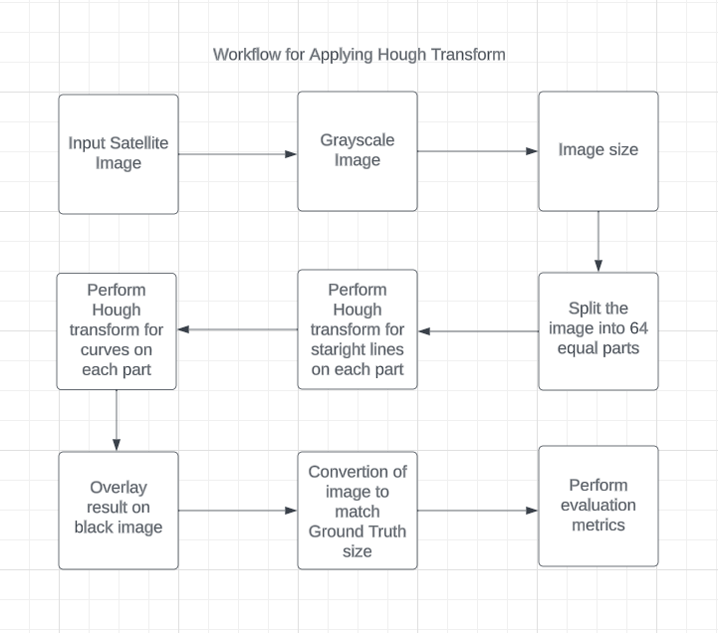
Workflow for Applying Hough Transform

Slide 31
Hough Transform Straight Lines only
Name | Size | Type | Filter | Accuracy* | Precision | SSIM
field | 2048 x 2048 | JPG | Hough Transform | 86.44 | 12.94 | 80.54
L88a | 2048 x 2048 | JPG | Hough Transform | 86.55 | 5.23 | 77.97
L88b | 2048 x 2048 | JPG | Hough Transform | 86.36 | 6.69 | 76.58
L96a | 2048 x 2048 | JPG | Hough Transform | 86.46 | 6.93 | 80.19
L96b | 2048 x 2048 | JPG | Hough Transform | 86.04 | 11.93 | 85.47
L97a | 2048 x 2048 | JPG | Hough Transform | 86.71 | 6.78 | 85.96
L97b | 2048 x 2048 | JPG | Hough Transform | 86.32 | 5.47 | 73.09
W107a | 2048 x 2048 | JPG | Hough Transform | 87.11 | 6.39 | 86.96
W107b | 2048 x 2048 | JPG | Hough Transform | 86.39 | 9.41 | 83.95
Average |  |  |  | 85.98 | 7.97 | 83.52

Slide 32
Table 3. Accuracy and Precision Table for Hough Transform (curves)
Name | Size | Type | Filter | SSIM | Precision | Accuracy*
field | 2048 x 2048 | JPG | Hough Transform | 8081.54 | 9.19 | 85.62
L88a | 2048 x 2048 | JPG | Hough Transform | 77.97 | 4.13 | 85.74
L88b | 2048 x 2048 | JPG | Hough Transform | 76.58 | 5.33 | 85.50
L96a | 2048 x 2048 | JPG | Hough Transform | 80.19 | 5.48 | 85.65
L96b | 2048 x 2048 | JPG | Hough Transform | 85.47 | 8.9 | 85.26
L97a | 2048 x 2048 | JPG | Hough Transform | 85.96 | 5.19 | 85.88
L97b | 2048 x 2048 | JPG | Hough Transform | 73.09 | 4.40 | 85.53
W107a | 2048 x 2048 | JPG | Hough Transform | 86.96 | 4.05 | 86.32
W107b | 2048 x 2048 | JPG | Hough Transform | 83.95 | 6.74 | 85.57
Average |  |  |  | 81.19 | 4.80 | 85.67

Slide 33
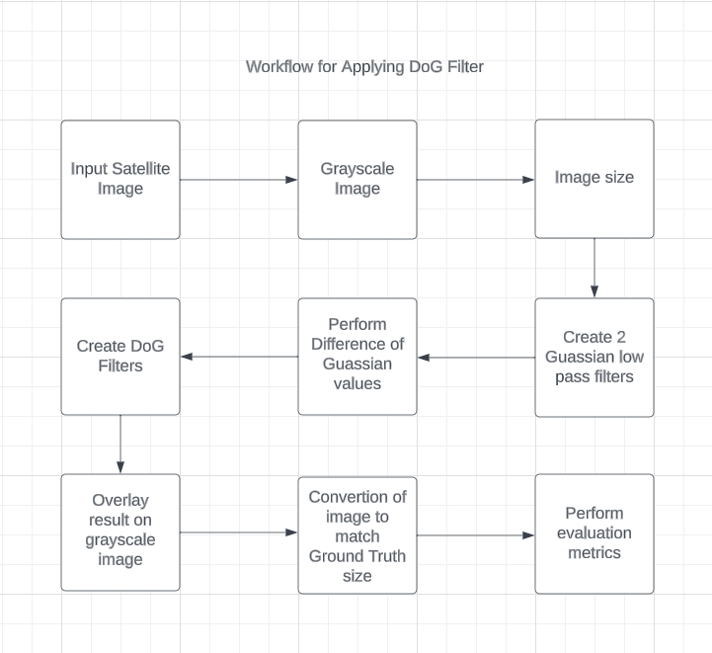
Workflow for Applying DoG Filter

Slide 34
Table 4. Accuracy and Precision Table for Difference of Gaussian (DoG)
Name | Size | Type | Filter | Accuracy | Precision | SSIM
field | 2048 x 2048 | JPG | DoG | 81.82 | 14.21 | 76.8
L88a | 2048 x 2048 | JPG | DoG | 81.21 | 8.87 | 69.10
L88b | 2048 x 2048 | JPG | DoG | 79.16 | 11.32 | 64.82
L96a | 2048 x 2048 | JPG | DoG | 81.40 | 9.70 | 71.84
L96b | 2048 x 2048 | JPG | DoG | 81.59 | 15.64 | 77.94
L97a | 2048 x 2048 | JPG | DoG | 80.61 | 9.83 | 72.50
L97b | 2048 x 2048 | JPG | DoG | 79.47 | 8.05 | 61.54
W107a | 2048 x 2048 | JPG | DoG | 84.13 | 9.41 | 82.61
W107b | 2048 x 2048 | JPG | DoG | 80.27 | 14.72 | 70.471
Average |  |  |  | 81.07 | 11.31 | 71.95

Slide 35
Result
From all the methods like Canny, Sobel with many variations in thresholds, Harris Corner, Hough Transform, Hough Transform with splitting, DOG Filter that we have developed and tested. From the results we can see that DoG is more consistent and produces better results when compared to all the other models.Models like Canny and Sobel are Fail cases where the detection is not upto the mark as we have expected. The detection is not consistent.

Slide 36
Conclusion
By using Gaussian and difference of Gaussian and converting the result image to binary we have brought our image close to ground truth and also if there was still any time we would like to perform some other operations like using Harris corner detection with Hough Transform splitting Technique on the image.

Slide 37
Timeline
Method | Start Date | End Date
Canny Edge | October 1 | October 15
Sobel Edge | October 1 | October 15
Histogram Equalization | October 1 | October 15
Histogram stretching | October 15 | October 15
Harris Corner Detection | October 16 | October 30
Hough Transform | October 16 | October 30
Hough Transform for Curves | November 1 | November 12
DoG Filter | November 1 | November 12
Full Report | November 16 | November 30
Presentation Including All | November 16 | November 30

Slide 38
Future Work
Methods That can be implemented in Future
1. Implementing Harris + Hough
2. Gabor Filter
3. Hough + DoG

Slide 39
References
https://stackoverflow.com/questions/39123267/how-to-detect-smooth-curves-in-matlab
Apeer.com
Matlab Documentation

Slide 40
Thank You

